Slide 1
Network Search
MA 653: Network Science
Instructor: Ashok Singh Sairam
ashok@iitg.ac.in

Slide 2
Web search
Information networks store large amounts of data in their vertices
These information is useless unless we find a way to navigate through the network and find the appropriate vertices
Web is on very illustrative example of such an information network
The Web is a directed network, where vertices are the webpages and the edges are the directed links between the pages
Webpages include information and the goal of web search engines is to identify those vertices (i.e., webpages) that include the most relevant information

Slide 3
Web search process
Offline web search is a multistage process
Crawling: find webpages,
Extraction: record their contents,
Indexing: create an annotated index of those contents (including list of words and importance of the pages based on a variety of criteria)
User submits a text query
Search engine extracts a list of pages matching the query from the index
Search engines based solely on indexes and textual criteria do not return good results

Slide 4
Modern web search engines make use of text annotation and indexes but only as a first step
Use index to find a set of candidate pages also possibly irrelevant with the query web pages
Network metrics are further used to narrow down these sets
Google uses the PageRank centrality metric
Pagerank accords pages a high score if they receive hyperlinks from many other pages
The interesting point is that PageRank (and in general any centrality measure that might be used) does not depend on the specific query
Hence, it can be computed offline, accelerating significant the response time

Slide 5
Of course PageRank has disadvantages too
A webpage might have a high PageRank value for a reason unrelated to the current search query

Slide 6
Overall process behind search engine
Crawling: Find web pages
Indexing: Process the text of the webpages to create an annotated index
Centrality measure: Use the link structure of the hyperlinks to calculate a centrality score such as page rank
When user submits query, extract a broad set of matching pages using index and score them such as frequency of query word
Combine the score with the precomputed similarity measure and other scores to give an overall score
Sort the pages based on overall score, say top 10.

Slide 7
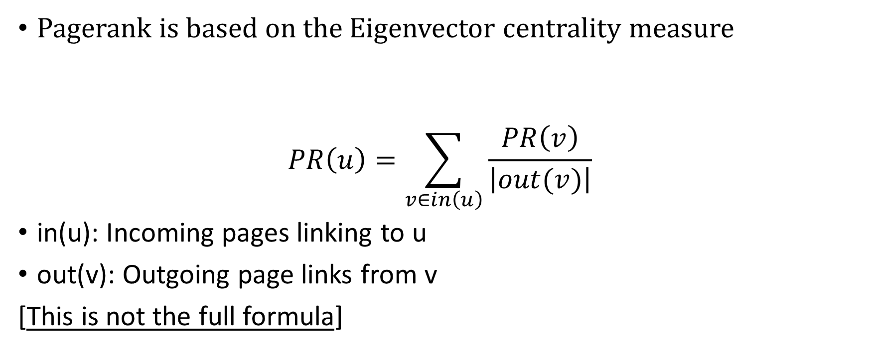
Simplified Pagerank
Pagerank is based on the Eigenvector centrality measure
$$PR\left(u\right)=\sum_{v∈in\left(u\right)}{\frac{PR\left(v\right)}{\left|out(v)\right|}}$$
in(u): Incoming pages linking to u
out(v): Outgoing page links from v
[This is not the full formula]

Slide 8
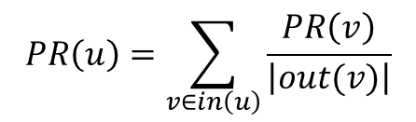
Pagerank: Algorithm
Iteration 0: Initialize all ranks to be 1/(number of total pages).
Iteration 1: For each page u, update u’s rank
Iteration 2: Continue
When to stop?
Why do we calculate the pagerank multiple times?
$$PR\left(u\right)=\sum_{v∈in\left(u\right)}{\frac{PR\left(v\right)}{\left|out(v)\right|}}$$

Slide 9
Pagerank: Example
1
2
3
4
5

Slide 10
Pagerank: Nodes with no incoming links
In this example, every page would start out with a rank of 0.25
After the first iteration, the PageRank of 1 is 0.75
Pagerank of 2, 3 and 4 is 0. The sum does not add to 1!
Our simplified Pagerank equation needs to be modified
2
4
1
3

Slide 11
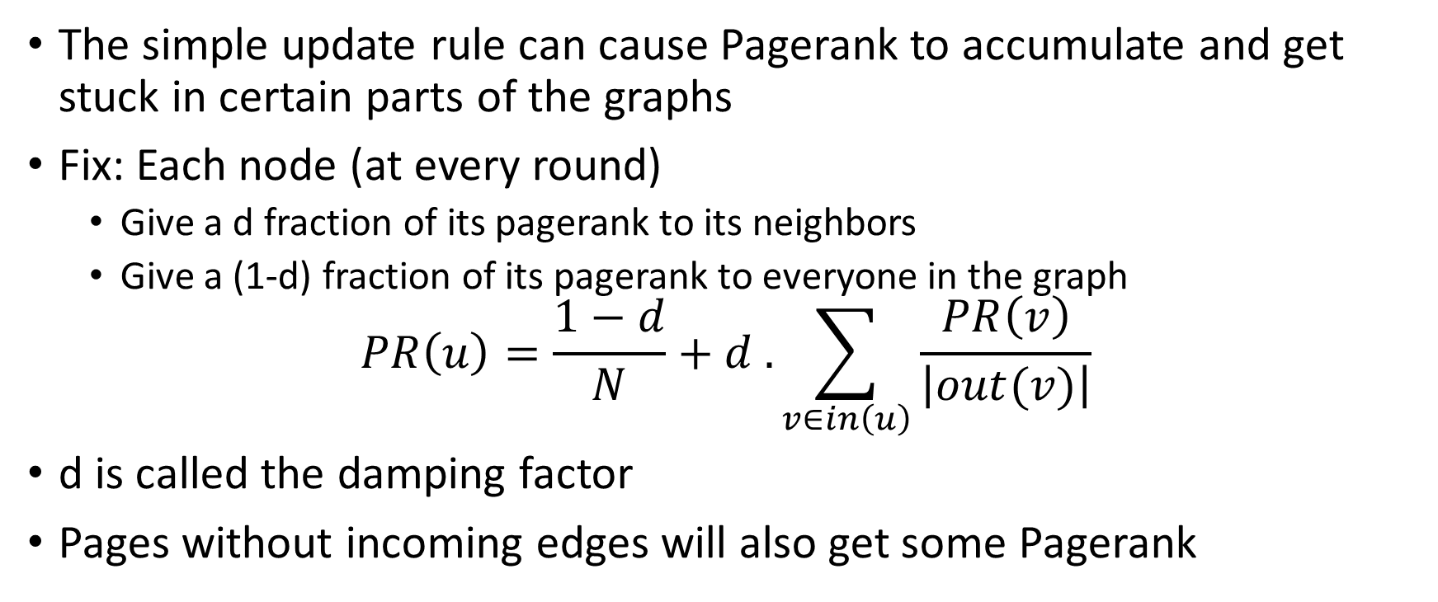
Pagerank: without sink node
The simple update rule can cause Pagerank to accumulate and get stuck in certain parts of the graphs
Fix: Each node (at every round)
Give a d fraction of its pagerank to its neighbors
Give a (1-d) fraction of its pagerank to everyone in the graph
$$PR\left(u\right)=\frac{1−d}{N}+d . \sum_{v∈in\left(u\right)}{\frac{PR\left(v\right)}{\left|out(v)\right|}}$$
d is called the damping factor
Pages without incoming edges will also get some Pagerank

Slide 12
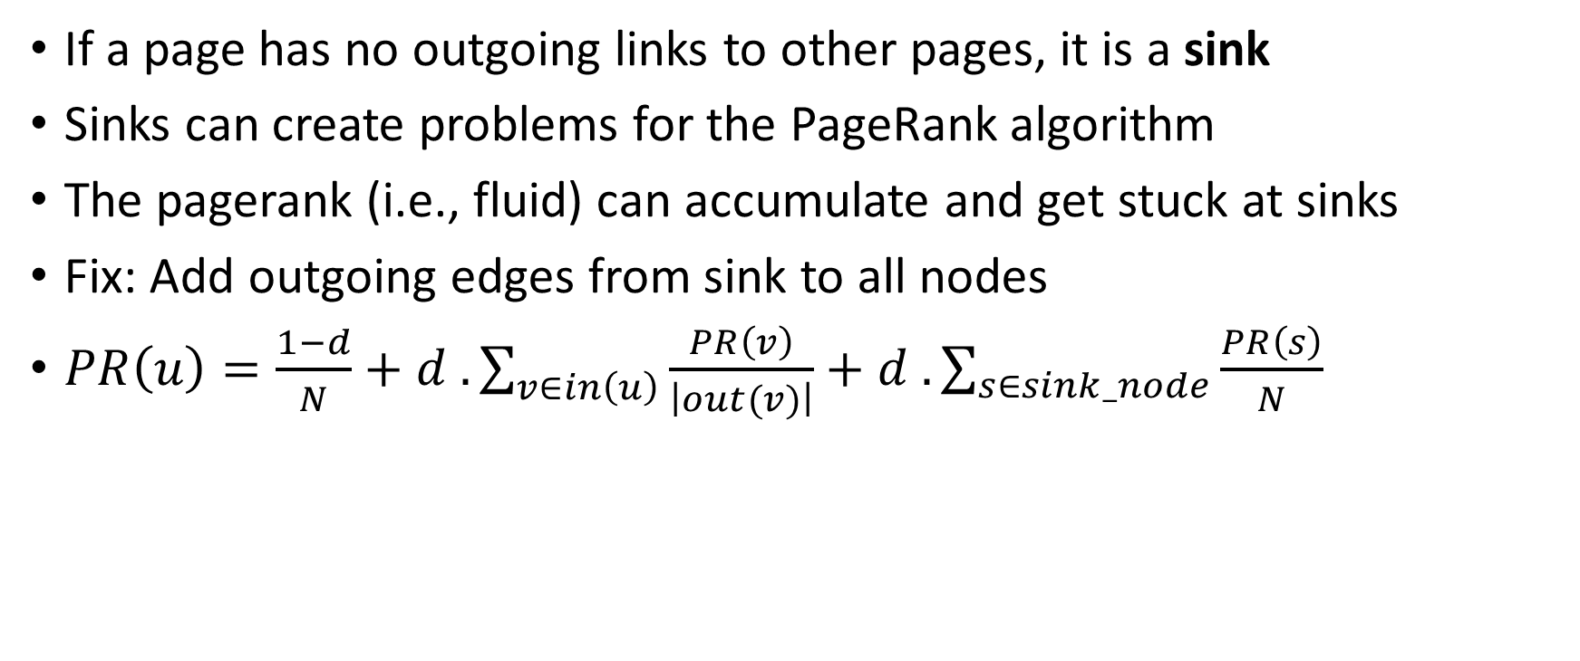
Pagerank: Final formula
If a page has no outgoing links to other pages, it is a sink
Sinks can create problems for the PageRank algorithm
The pagerank (i.e., fluid) can accumulate and get stuck at sinks
Fix: Add outgoing edges from sink to all nodes
$PR\left(u\right)=\frac{1−d}{N}+d . \sum_{v∈in\left(u\right)}{\frac{PR\left(v\right)}{\left|out(v)\right|}}+d . \sum_{s∈sink_node}{\frac{PR\left(s\right)}{N}}$

Slide 13
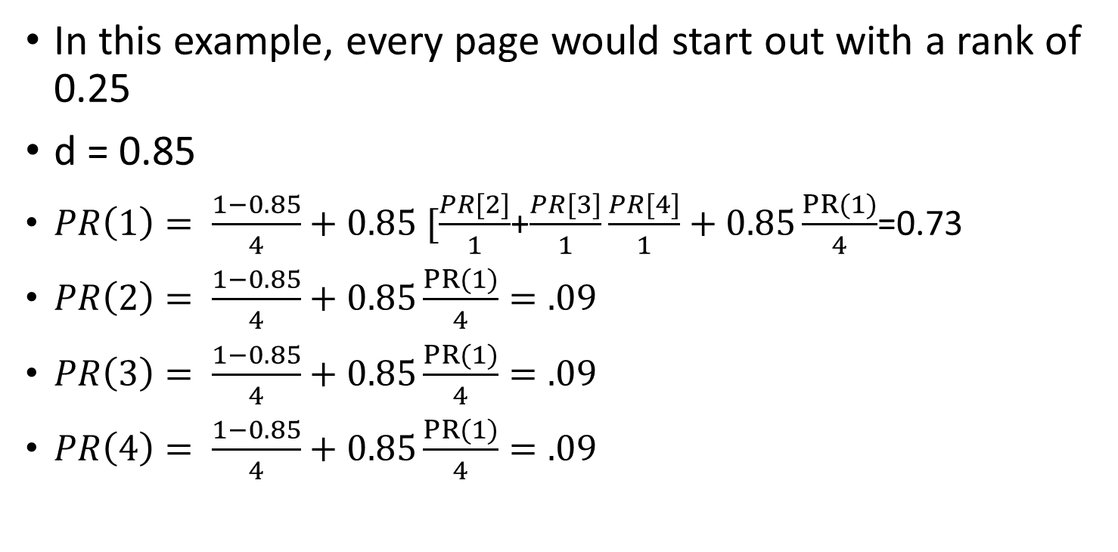
Pagerank: Nodes with no incoming links
In this example, every page would start out with a rank of 0.25
d = 0.85
$PR\left(1\right)= \frac{1−0.85}{4}+0.85 [\frac{PR[2]}{1}$+$\frac{PR[3]}{1}\frac{PR[4]}{1}+0.85\frac{PR(1)}{4}$=0.73
$PR\left(2\right)= \frac{1−0.85}{4}+0.85\frac{PR(1)}{4}=.09$
$PR\left(3\right)= \frac{1−0.85}{4}+0.85\frac{PR(1)}{4}=.09$
$PR\left(4\right)= \frac{1−0.85}{4}+0.85\frac{PR(1)}{4}=.09$
2
4
1
3

Slide 14
Modern search engines
Google uses a sophisticated set of algorithms (beyond just PageRank) to evaluate and rank web pages for specific search queries.
These algorithms analyze hundreds of ranking signals to determine the relevance, authority, and quality of web pages.
Some important ranking signals include
the relevance of content to the search query,
the authority of the website,
user experience metrics (like page load speed and mobile-friendliness),
and the overall trustworthiness of the domain.

Slide 15
Searching distributed databases
Some info. take the form of distributed databases such as peer-to-peer file sharing (BitTorrent)
In a peer-to-peer network participating users have specific files that they store in their machine(s)
Users are logically connected (similar to webpages)
An edge between two users does not mean that they are physically connected but they have an overlay communication
They are “neighbors” in the network
Searching is a fundamental problem in peer-to-peer networks

Slide 16
Searching distributed databases: Options
One could take an approach similar to web search
Central entity that has all the entries “who has what”
Keeping these databases centrally is not a good idea
High load, single point of failure etc.
How can we search in this distributed database?
Simple but naïve approach (BFS)
Entries are randomly scattered across peers
When a peer wants to query a key (eg. file name) sends the query to all the peers
If the peer has the file send it back, else send a further query to each of the neighbours
Does not scale (huge traffic/query load and needs to keep track of all the peers)

Slide 17
Naïve approach: Pros and Cons
Pros:
Assuming that the network displays small-world effect, the #steps in the BFS will be small
Means small amount of search time
Cons:
Search does not stop, when the file is found
No mechanism to inform that the file has been found and the search needs to stop
Message transmitted can become linear to the size of the network
#message per query: O(n), where n is the #peers
If average query rate per user is r, so overall rate of query is rn=O(n)
Total #messages sent/time: O(n^2)
Peer-to-peer networks can become very large, so n will be large
Total #message sent per node per unit time:O(n^2)/n=O(n)

Slide 18
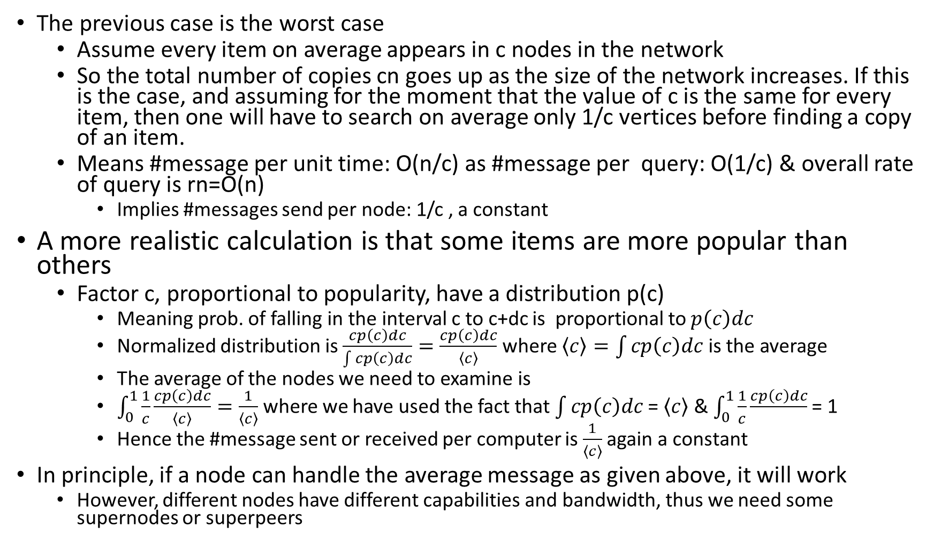
The previous case is the worst case
Assume every item on average appears in c nodes in the network
So the total number of copies cn goes up as the size of the network increases. If this is the case, and assuming for the moment that the value of c is the same for every item, then one will have to search on average only 1/c vertices before finding a copy of an item.
Means #message per unit time: O(n/c) as #message per query: O(1/c) & overall rate of query is rn=O(n)
Implies #messages send per node: 1/c , a constant
A more realistic calculation is that some items are more popular than others
Factor c, proportional to popularity, have a distribution p(c)
Meaning prob. of falling in the interval c to c+dc is proportional to $p\left(c\right)dc$
Normalized distribution is $\frac{cp\left(c\right)dc}{\int{cp\left(c\right)dc}}=\frac{cp\left(c\right)dc}{\left\langle c\right\rangle }$ where $\left\langle c\right\rangle =\int{cp\left(c\right)dc}$ is the average
The average of the nodes we need to examine is
$\int_{0}^{1}{\frac{1}{c}}\frac{cp\left(c\right)dc}{\left\langle c\right\rangle }=\frac{1}{\left\langle c\right\rangle }$ where we have used the fact that $\int{cp\left(c\right)dc}$ = $\left\langle c\right\rangle$ & $\int_{0}^{1}{\frac{1}{c}}\frac{cp\left(c\right)dc}{}$ = 1
Hence the #message sent or received per computer is $\frac{1}{\left\langle c\right\rangle }$ again a constant
In principle, if a node can handle the average message as given above, it will work
However, different nodes have different capabilities and bandwidth, thus we need some supernodes or superpeers

Slide 19
Supernodes design
Most modern peer-to-peer networks deploy a hierarchical overlay of supernodes
Supernodes (superpeers) are high-bandwidth nodes
Each client connect to a supernode
The supernode keep track of the files each one of its client has
Queries are forwarded to the supernode
which initiates the BFS
Entire search performed at supernodes
There are more sophisticated models
such as Chord.

Slide 20
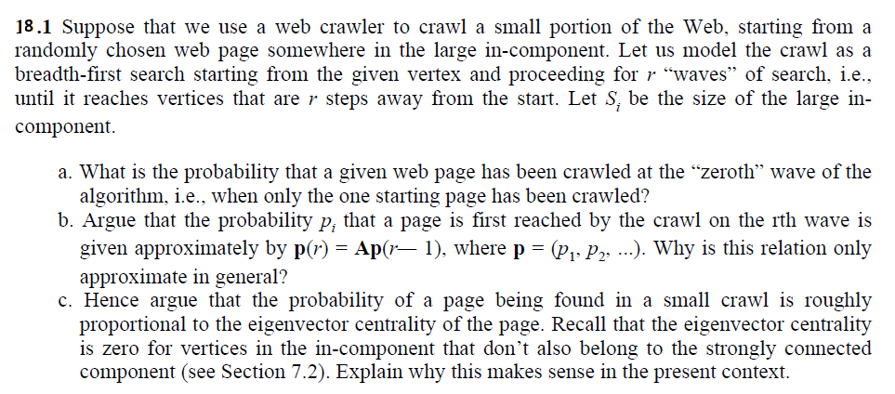
Ex:

